Slide 1
An Introduction to Python
Ziyi Xi
05/28/2019

Slide 2
Why we are programming?
An important skill in the information era.
Develop what we like, automize anything in our life.
Important in research.
High salary jobs.
…

Slide 3


Why we are using python?

Slide 4
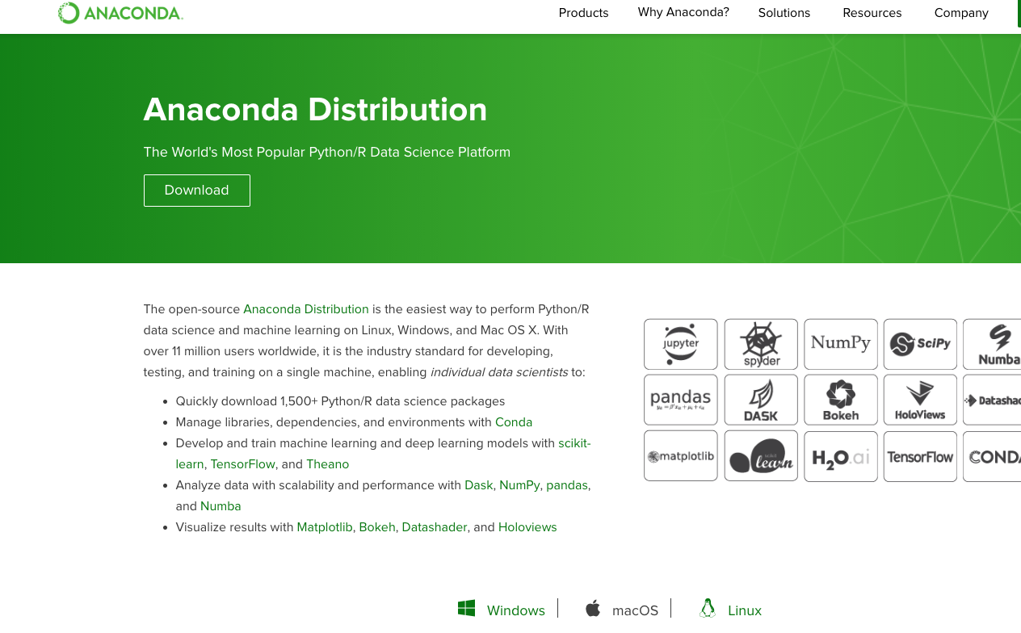
How to Install python?

Slide 5
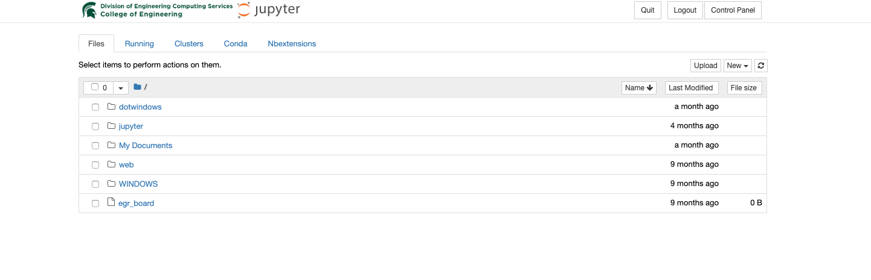
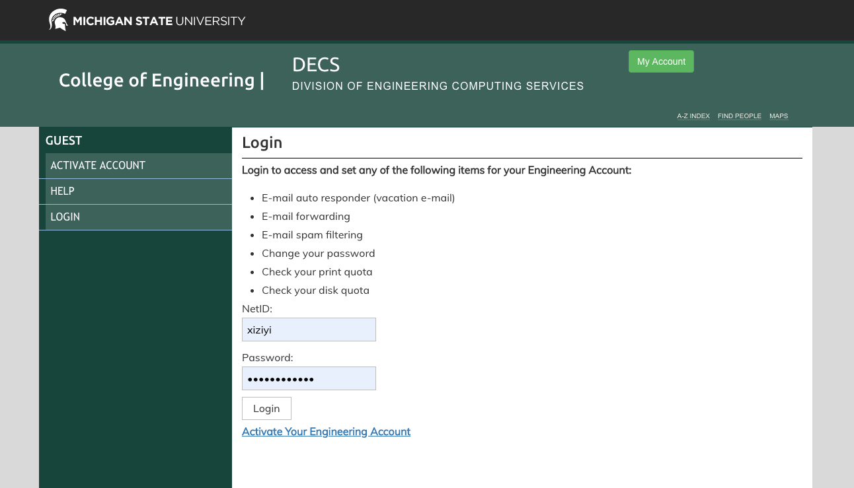
Use EGR’s jupyterhub

Slide 6
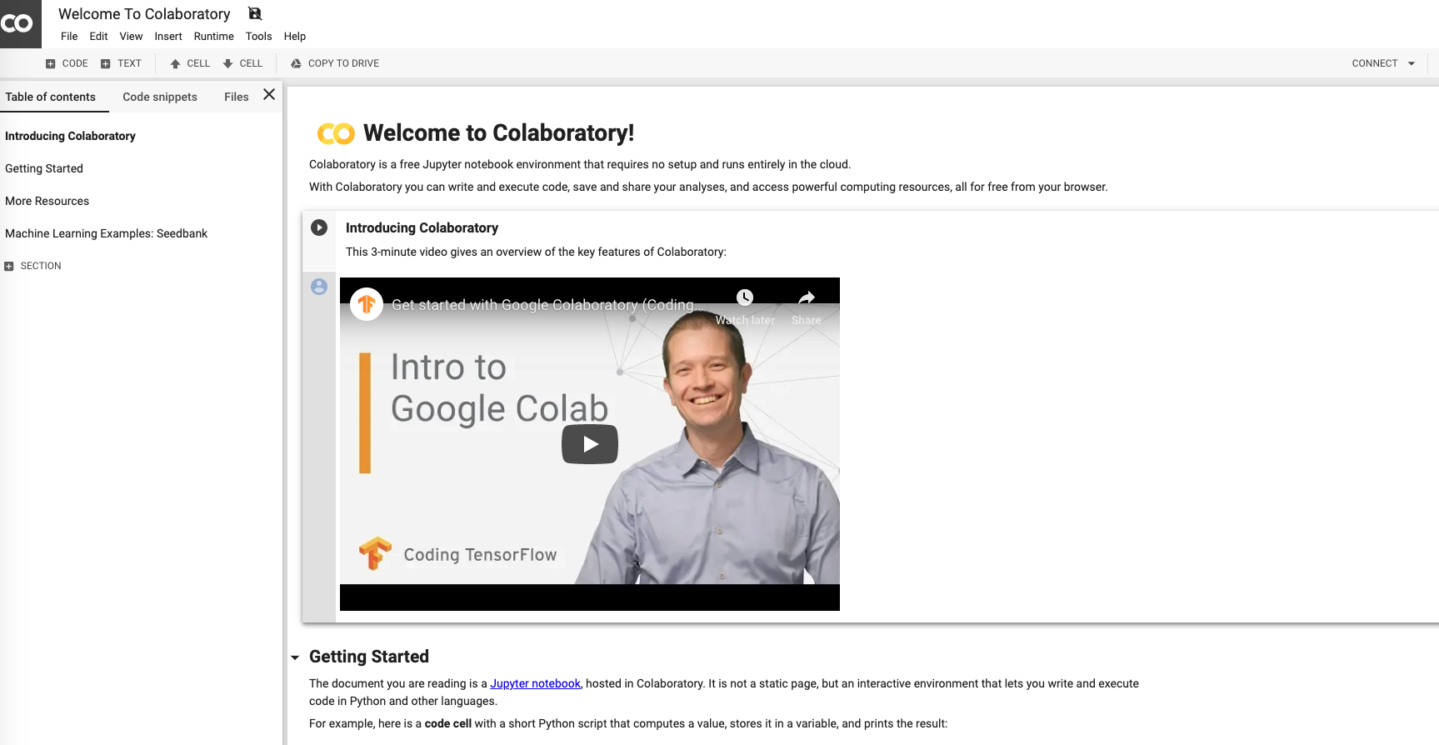
Use Google's colab

Slide 7
Jupyter notebook

Slide 8
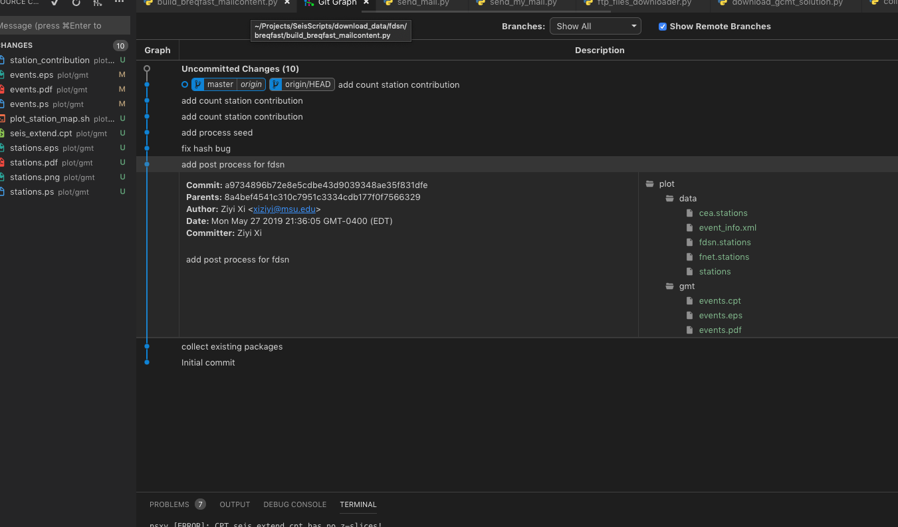
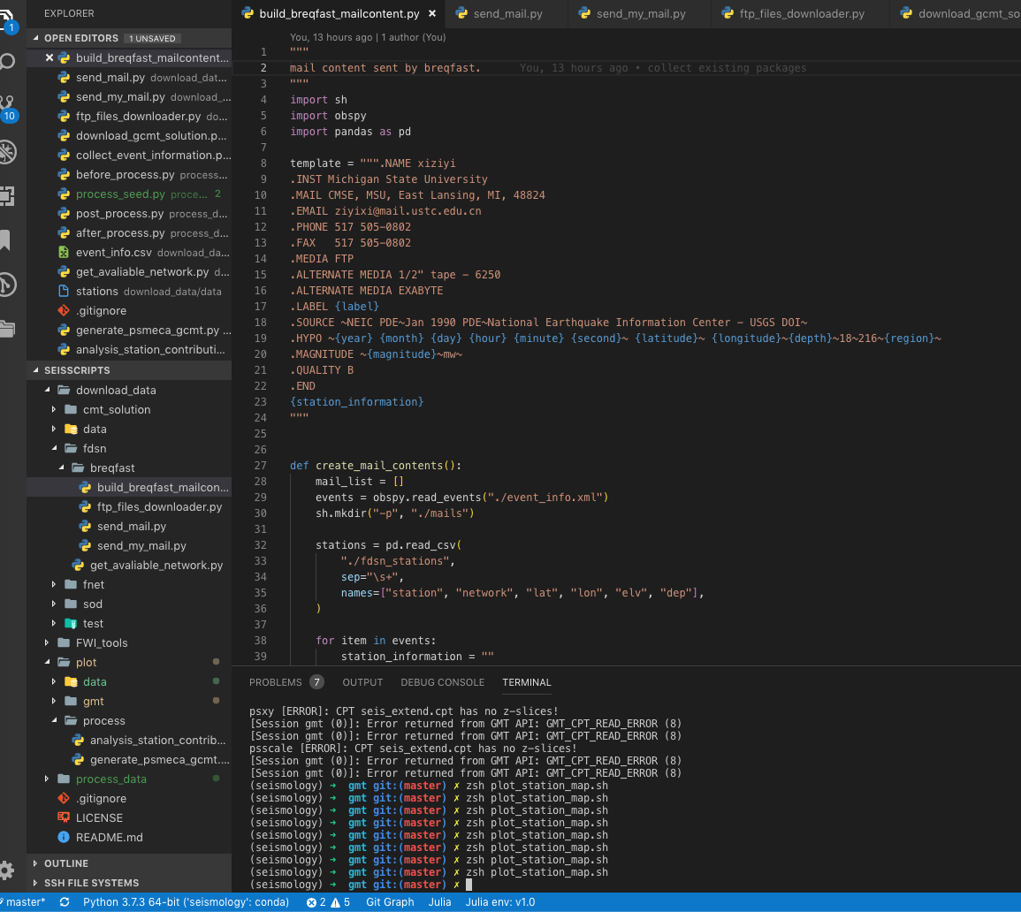
Python in vscode

Slide 9
The fundamentals
https://github.com/krischer/mess_2019/blob/master/1_monday/00_Python_Crash_Course-with_solutions.ipynb

Slide 10
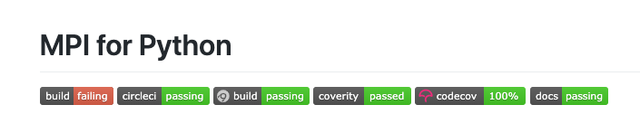

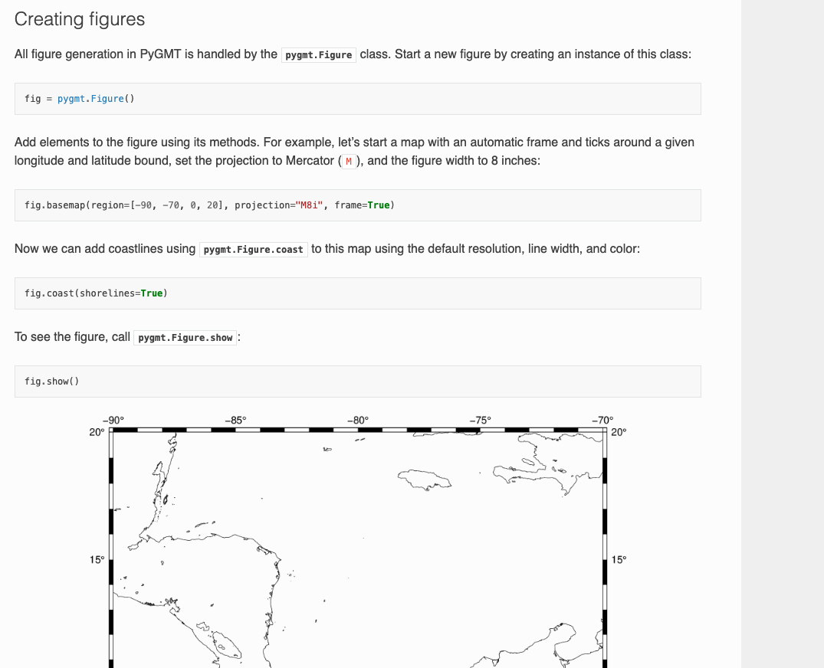
Interesting things for learning python

